Slide 1
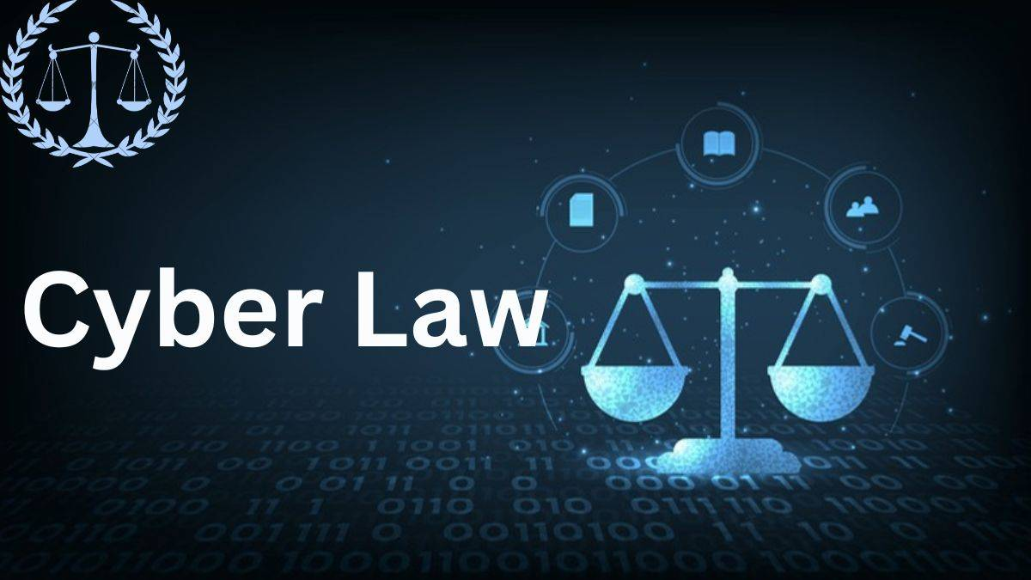
Session 12
Cyber Law with Equifax Case Study

Slide 2

Learning Outcomes :
By the end of this session, you will:
Explain how the use of computing can raise legal and ethical concerns.
Analyze multiple real-world cases under cyber law frameworks.
Assess an organization's cybersecurity policies and compliance status.
Describe the incident response process for handling security breaches.

Slide 3

Understand :
What You Will Explore:
Cyber Law Basics What constitutes a cybercrime? Overview of legal principles governing IT.
Legal & Ethical Concerns in Computing Privacy violations, unauthorized access, data misuse.
Cybersecurity Compliance & Policy How organizations align with laws like GDPR, IT Act, HIPAA.
Case Analysis Breakdown of landmark cases—Sony PSN hack, Equifax breach, Aadhaar privacy challenge.
Incident Management How to respond to a breach: detection, containment, notification, and recovery.

Slide 4
What Is Cyber Law?
Cyber Law governs digital activities such as data access, internet use, software, digital communication, and cybercrime.
It provides the legal framework to address unauthorized access, hacking, privacy violations, identity theft, and data breaches.
Enforced through various national and international statutes (e.g., IT Act 2000 – India, GDPR – EU).
Cyber Ethics involve the responsible and lawful use of digital technology.
Essential to ensure accountability, security, and trust in the digital age.

Slide 5
How Do Cyber Laws Operate?
Policy Enforcement: Organizations must comply with data protection laws and internal policies.
Incident Response: Laws guide how to report, investigate, and recover from breaches.
Legal Accountability: Laws define penalties for cyber offenses (fines, imprisonment, sanctions).
Forensics & Evidence Collection: Legal standards dictate admissibility of digital evidence.
Cross-Border Enforcement: Mutual legal assistance treaties (MLATs) are used for international crimes.

Slide 6
Types of Legal and Ethical Issues in Computing
Unauthorized Access: Hacking or accessing systems without permission.
Data Theft & Privacy Violation: Breaching personal or financial information.
Software Piracy: Use or distribution of unlicensed software.
Defamation & Cyberbullying: Using digital platforms to harass or damage reputation.
Intellectual Property Violations: Unauthorized use of copyrighted content, trademarks, or patents.

Slide 7
Impacts : Legal and Organizational Impacts of Cyber Incidents
Reputation Damage: Loss of public trust due to breaches or poor incident handling.
Financial Penalties: Legal fines for non-compliance (e.g., GDPR violations up to €20M).
Operational Disruption: Downtime during forensic investigation and recovery.
Regulatory Scrutiny: Increased oversight after reported incidents.
Loss of Business: Clients may leave due to poor security posture or ethics.

Slide 8
Real World Example
Case Study: Facebook–Cambridge Analytica Scandal
What Happened? Data from over 87 million users was harvested via Facebook and used for political advertising without consent.
Legal Outcome: Facebook was fined $5 billion by the FTC for violating users' privacy rights.
Key Legal/Ethical Issues:
Consent and transparency in data collection.
Misuse of digital platforms for manipulation.
Organizational responsibility for third-party access.
Learning Point: Reinforces the need for strict compliance and ethical governance in digital platforms.

Slide 9
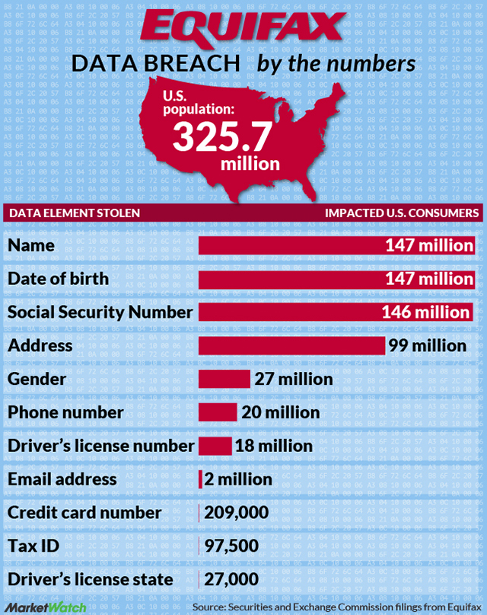
Case Study Overview
Case Study: The Equifax Data Breach (2017)
What Happened? Sensitive data of 147 million individuals was exposed due to an unpatched Apache Struts vulnerability.
Legal Implications: Equifax was fined $700 million for failing to protect consumer data—highlighting duty of care and breach notification failures.
Key Learnings:
Importance of timely patching.
Need for internal controls and compliance.
Legal obligation to notify and compensate affected users.

Slide 10

Case Study: The Equifax Data Breach (2017)
Key Learnings from Equifax Case
Importance of timely patching and vulnerability management.
Internal compliance systems must ensure security best practices.
Organizations have a legal obligation to notify affected users.
Post-breach response and transparency are critical to reducing impact.

Slide 11
Case Study: The Equifax Data Breach (2017)
Incident Management Process (Context: Equifax)
Detection – Vulnerability remained unnoticed for months.
Containment – Once discovered, breach mitigation began.
Investigation – Scope of breach and entry point analyzed.
Notification – Public disclosure and regulatory reports.
Compensation – Affected users offered credit monitoring and damages

Slide 12
Case Study: The Equifax Data Breach (2017)
Compliance Reflection – Could It Be Prevented?
Patch Management Failure: Yes, if regular patch management practices were followed, the vulnerability could have been mitigated.
Audit & Testing Gaps: Security audits and external penetration tests could have flagged the vulnerability in advance.
Compliance Weaknesses: Weak oversight of compliance requirements allowed the issue to persist.
Communication Silos: Poor coordination between IT and legal/compliance teams hindered effective governance.
Delayed Response: Time taken to detect and respond worsened the impact.
Need for Proactive Culture: A risk-aware and proactive cybersecurity culture could have prevented such negligence.

Slide 13
Types of Cybercrime
Hacking: Unauthorized access to digital systems.
Phishing: Fraudulent attempts to obtain sensitive information via deceptive emails or websites.
Ransomware: Malicious software that locks access to systems/data until a ransom is paid.
Identity Theft: Using someone else's personal data for fraud.
Cyberstalking & Online Harassment: Persistent online threats or harassment.
Online Fraud & Financial Crimes: E-commerce scams, fake digital transactions.

Slide 14
Punishments Under Law (India & Global)
India (IT Act, 2000):
Hacking: Up to 3 years imprisonment or fine up to Rs. 5 lakh.
Data Theft: Up to 3 years and/or fine.
Sending offensive messages: Up to 3 years.
Global (examples):
USA (CFAA): Hacking can result in up to 20 years imprisonment.
EU (GDPR): Non-compliance may lead to fines up to €20 million or 4% of global turnover.

Slide 15
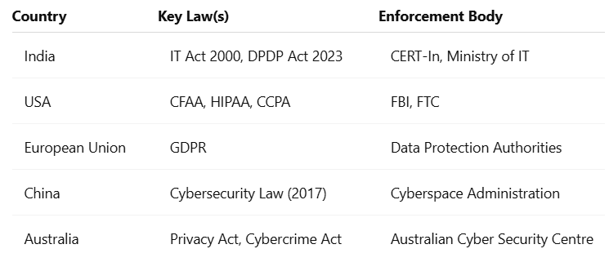
Cyber Law by Country Comparison

Slide 16

Incident Response Process
Managing a Security Breach
Detection – Identify suspicious activity through monitoring or alerts.
Containment – Isolate affected systems to prevent spread.
Investigation – Collect forensic evidence and determine cause.
Notification – Inform stakeholders, regulators, and possibly the public.
Remediation – Patch vulnerabilities, update systems, and resecure environment.
Review & Audit – Assess the incident, improve policies, and prepare reports.

Slide 17
Future Trends: Where Are Cyber Laws Headed?
Stronger Global Regulations: Nations adopting comprehensive data protection laws (e.g., India’s Digital Personal Data Protection Act).
AI & Ethics Regulation: Addressing ethical concerns in AI decision-making.
Cross-Border Data Jurisdiction: Managing data hosted in foreign countries.
Cybercrime Treaties: International frameworks like the Budapest Convention are expanding.
Increased Corporate Liability: Executives held responsible for security lapses.

Slide 18



Exercise
What was the key vulnerability that led to the Equifax data breach in 2017? A) Weak passwords in user accounts B) Phishing attacks on employees C) An unpatched software flaw in Apache Struts D) Malware from external USB devices Answer: C
Under cyber law, what is a major consequence of non-compliance with data protection regulations like GDPR? A) Suspension of internet services B) Immediate company shutdown C) Financial penalties and regulatory scrutiny D) Mandatory password resets for users Answer: C

Slide 19
Exercise
What does the “Notification” step in the incident response process involve? A) Deleting all affected data B) Informing stakeholders, regulators, and possibly the public C) Rebooting all compromised systems D) Restoring the company’s reputation via advertising Answer: B
In cyber law, what is the primary purpose of legal frameworks like the IT Act and GDPR? A) To encourage cloud storage usage B) To penalize users for slow internet C) To protect digital rights and regulate cybercrimes D) To promote software development skills Answer: C
What ethical concern was central to the Facebook–Cambridge Analytica scandal? A) Copyright infringement B) Data misuse without user consent C) Selling fake products D) Excessive advertising Answer: B

Slide 20
Conclusion
Wrap-Up: The Role of Cyber Law in Digital Society
Cyber laws protect rights, data, and infrastructure in the digital domain.
Ethical computing goes hand-in-hand with legal compliance.
Case studies illustrate the real-world consequences of poor security or unethical behavior.
Every organization must assess its cybersecurity status and prepare for incident response.
As digital threats grow, so must our legal awareness and proactive governance.

Slide 21

Quiz
Now it's time to apply your knowledge! Click the link below to take an interactive quiz in the Streamlit app. This quiz will test your understanding of Cyber Law and its importance in Cyber Security.
How to Approach the Quiz:
Choose Your Answers Carefully: Think about how different authentication methods work and how they help secure information and systems.
Test Your Knowledge: The quiz will help you check how well you understand how Cyber Law protects your data and prevents unauthorized access.
Click here to start the quiz:https://www.asianlaws.org/cyber-law-quiz.php

Slide 22
Mock Quiz : Cyber Law Knowledge Check
1. What does GDPR stand for? a) General Data Protection Regulation b) Global Digital Protection Rule c) General Digital Protection Rights Answer: a)
2. Which of the following is considered a cybercrime? a) Online shopping b) Hacking c) Blogging Answer: b)
3. What is the punishment for identity theft under the IT Act (India)? a) 6 months imprisonment b) 3 years imprisonment and/or fine c) No punishment Answer: b)

Slide 23
Mock Quiz : Cyber Law Knowledge Check…
4. Which international treaty covers global cooperation in cybercrime investigation? a) Hague Convention b) Budapest Convention c) Vienna Convention Answer: b)
5. Who enforces GDPR in the European Union? a) INTERPOL b) European Cyber Bureau c) Data Protection Authorities Answer: c)

